Slide 1


K-12 Education: Live Video Conferencing, Streaming, Storage and Playback

Slide 2
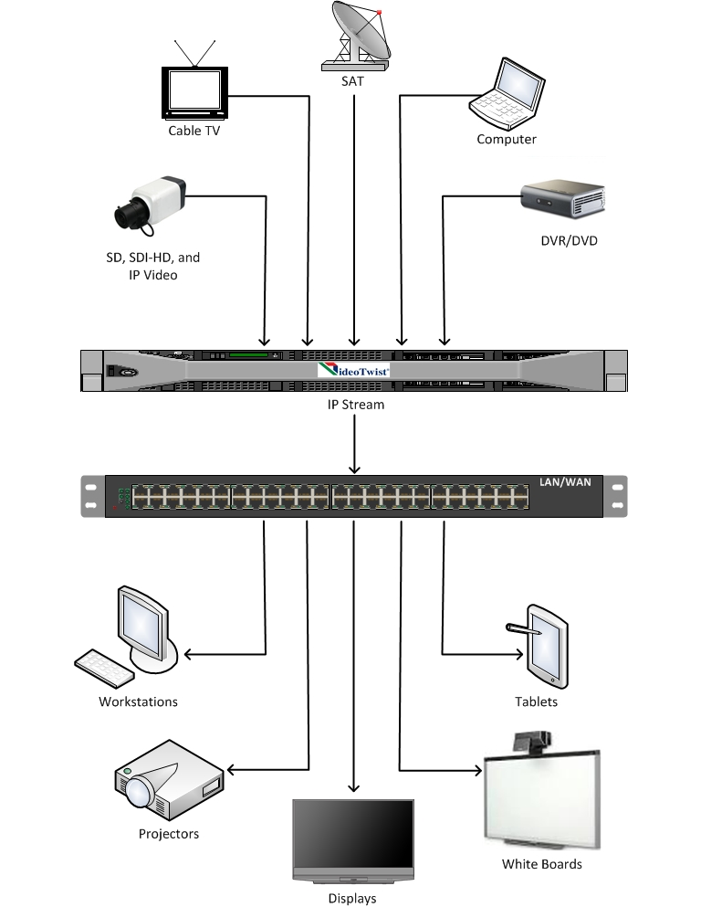
K-12 Education: Live Video Conferencing, Streaming, Storage and Playback
Educators agree that the advantages of using video as an element in the delivery of educational content benefits students across all grade levels. Improve lesson retention by providing access to live streaming programs for distance education delivery, or access to pre-recorded material from a centralized media library

Slide 3
K-12 Education: Live Video Conferencing, Streaming, Storage and Playback
The VideoTwist 5080 provides educators with an easy way to share and distribute high quality video and audio content between classrooms and schools by streaming educational resources as IP video sources over local or wide area networks. Integrate IP video with existing network infrastructure to provide streaming of live event broadcasts from school sporting events to student generated content

Slide 4
K-12 Education: Live Video Conferencing, Streaming, Storage and Playback
Control the delivery of television stations and content to classrooms with High Definition or Standard Definition IPTV
Capture and distribute student produced morning announcements
Emergency video announcements for individual Schools or District Wide
Distribution of IP-AV to Projectors, Whiteboards, LCD’s, Computers or Tablets

Slide 5
K-12 Education: Live Video Conferencing, Streaming, Storage and Playback
Capture real-time video/audio content for Video-On-Demand (VOD) playback
Extend classrooms to homebound students
Interact over live video conferencing
Capture remote IP cameras to stream live event broadcasts from school sporting events to student generated content

Slide 6
K-12 Education: Live Video Conferencing, Streaming, Storage and Playback
Television programing into the classrooms
Control the delivery of station access
Reduce replication equipment installation in each school
Record content for classroom delivery and managed VOD

Slide 7
K-12 Education: Live Video Conferencing, Streaming, Storage and Playback
Capture and distribution of student produced content
Morning announcements
Student presentations
Administrative announcements
Special events
Emergency video announcements for individual Schools or District Wide

Slide 8
K-12 Education: Live Video Conferencing, Streaming, Storage and Playback
Distribution of IP-AV content to Projectors, Whiteboards, LCD’s, Computers or Tablets
Content delivery as IP streams
Classroom computers connected to projectors, LCD displays, and annotation boards
Content streamed to tablet computers and iPads

Slide 9


K-12 Education: Live Video Conferencing, Streaming, Storage and Playback
Emergency video announcements and instructions for action - School or District Wide
Exit to the bus loading zone now

Slide 10

K-12 Education: Live Video Conferencing, Streaming, Storage and Playback
Capture real-time video/audio content for Video-On-Demand (VOD) playback

Slide 11
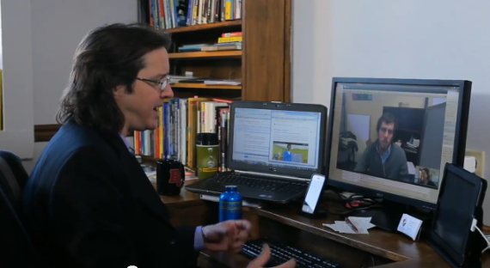
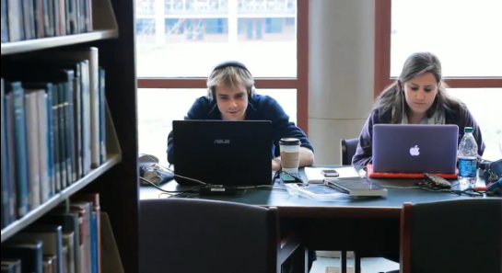
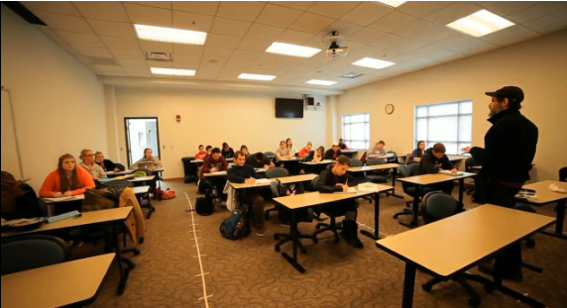
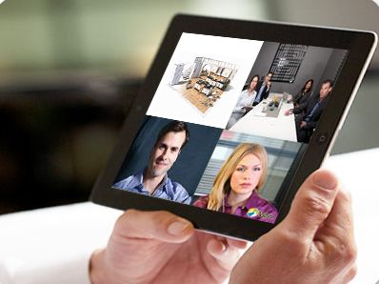
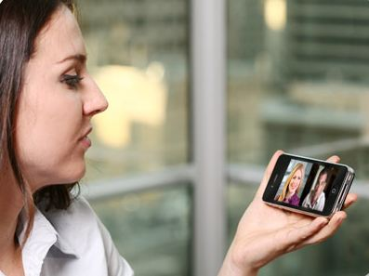
K-12 Education: Live Video Conferencing, Streaming, Storage and Playback
Interact over live video conferencing providing access for homebound students and opportunities for additional programing such as adult education classes.

Slide 12
K-12 Education: Live Video Conferencing, Streaming, Storage and Playback
Connect to remote IP cameras to capture and stream live sporting events from the school fields and stadiums. Provide access throughout the school districts, or world wide viewing over the internet. View as individual cameras or a quad view of multiple cameras.

Slide 13
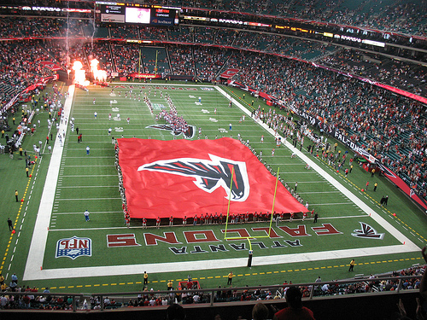
K-12 Education: Live Video Conferencing, Streaming, Storage and Playback
Connect to remote IP cameras to capture and stream live sporting events. View individual cameras or a quad view of multiple cameras.

Slide 14
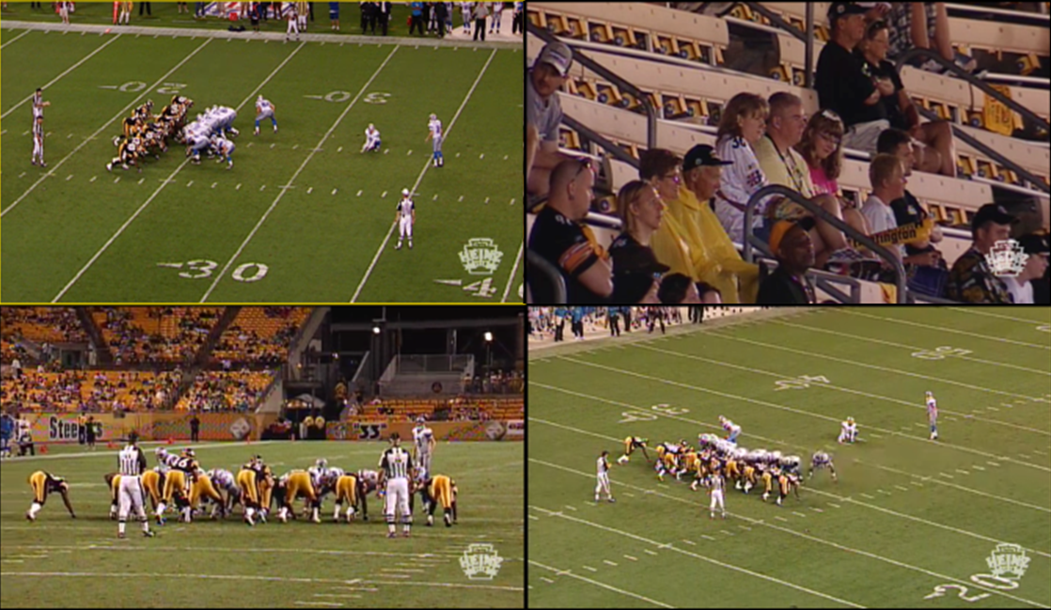
K-12 Education: Live Video Conferencing, Streaming, Storage and Playback
Connect to remote IP cameras to capture and stream live sporting events. View individual cameras or a quad view of multiple cameras.

Slide 15
K-12 Education: Live Video Conferencing, Streaming, Storage and Playback

